Slide 1
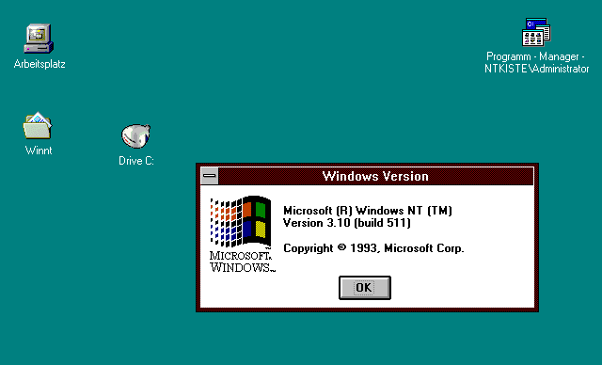
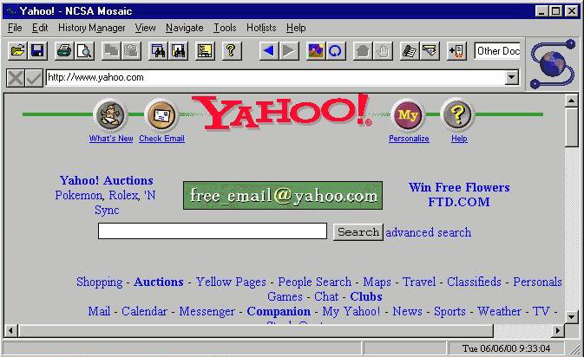
http://www.computerhistory.org/timeline/images/1993_mosaic_browser_large.jpg
MVC and the View
Notes:
1993 version of Mosaic browser.
Must be loading Yahoo! from the late 90s (note ’N Sync link).

Slide 2
Today’s Goal: Program “View” in Rails
Prerequisites:
How to program HTML
How the Web works
How Rails MVC architecture works

Slide 3
Today’s Goal: Program “View” in Rails
Prerequisites:
How to program HTML
How the Web works
How Rails MVC architecture works

Slide 4
What is HTML?
Implies links
Implies formatting tags
HyperText Markup Language
Main language for writing web pages that
can be displayed in a web browser

Slide 5

Brief History of HTML
1991ish: Born
Thru 1990s: Evolves
  Versions 0 to 4
By 2000: Ver. 4.01 wins!
  Still most common/supported?
2008: HTML5 introduced
  Rich media and mobility
  Finalized Oct ’14
  Not fully supported?
We’ll use

Slide 6
Web Pages = 3 Technologies
I’ll cover
HTML for Structure
Cascading Style Sheets (CSS) for Style
JavaScript for Behavior
Explore on your own

Slide 7
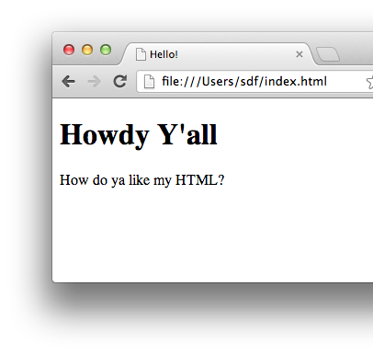
How HTML Works
You write HTML text
Then load it in a browser
<!DOCTYPE html>
<html>
<head>
<title>Hello!</title>
</head>
<body>
<h1>Howdy Y'all</h1>
<p>
How do ya like my HTML?
</p>
</body>
</html>

Slide 8
HTML Elements
Start tag
End tag
<p>This is a paragraph.</p>
Renders as
Note slash!
This is a paragraph.

Slide 9
Elements can be nested
Nested element
<p>This is a <b>paragraph</b>.</p>
Renders as
This is a paragraph.

Slide 10
Elements can have attributes
Attribute
<p style="color:blue">I'm blue!</p>
Renders as
Attribute
name
I’m blue!
Equals
Value
string

Slide 11
HTML Page Structure
Doctype info
<!DOCTYPE html>
<html>
<head>
<title>Hello!</title>
</head>
<body>
<h1>Howdy Y'all</h1>
<p>
How do ya like my HTML?
</p>
</body>
</html>
head element for metadata
html element
body element for content

Slide 12
Oh yeah, and …
A few tags don’t come in pairs:
  E.g.: <br> for line breaks
  E.g.: <img> for images
Browsers collapse whitespace (spaces, newlines):
  Consecutive whitespace treated as single space
  Leading/trailing whitespace eliminated
Special symbols:
  E.g.: &nbsp; for non-breaking space
  See: http://www.w3schools.com/html/html_entities.asp and http://www.w3schools.com/tags/ref_symbols.asp

Slide 13
Now, all you need to do is learn these tags: http://www.w3schools.com/tags/ref_byfunc.asp
(Ignore the ones marked “new” for now)
(Ignore the “not supported” ones)

Slide 14
Today’s Goal: Program “View” in Rails
Prerequisites:
How to program HTML
How the Web works
How Rails MVC architecture works

Slide 15
So how does the Web work?
When you open a web page in your browser, where does that HTML come from, and how does it get to your browser?

Slide 16
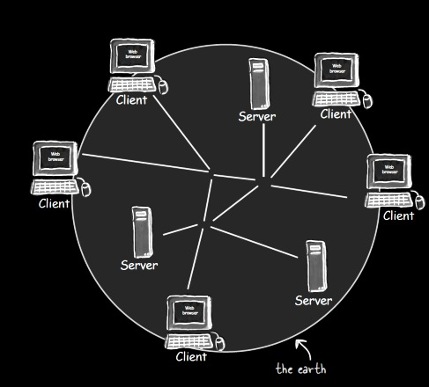
Architecture of the Web
Head First Servlets and JSP (2nd edition), p. 3

Slide 17
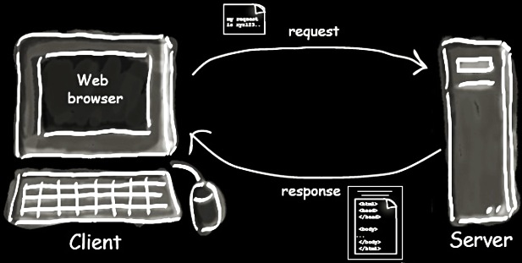
Client-Server Interaction
Head First Servlets and JSP (2nd edition), p. 4

Slide 18
How do you tell a browser to send a request to a particular server?
?
Head First Servlets and JSP (2nd edition), p. 3

Slide 19
URL (Uniform Resource Locator)
http://www.wickedlysmart.com:80/beeradvice/select/beer1.html
Server
Path
Resource
Port (optional)
Protocol (http, https, etc.)

Slide 20
What protocol do these interactions follow?
Head First Servlets and JSP (2nd edition), p. 4

Slide 21
HTTP (Hypertext Transfer Protocol)
Request “methods”
  GET: Retrieve resource
  POST: Create resource
  PATCH: Update resource
  DELETE: Destroy resource
  … more …
Response (only one type)
CRUD: 4 basic operations of persistent storage

Slide 22
Example HTTP GET Request
HTTP
Method
Path to
resource
Protocol
version
GET /select/selectBeerTaste.jsp HTTP/1.1
Host: www.wickedlysmart.com
User-Agent: Mozilla/5.0 (Macintosh; U; PPC Mac OS X…
Accept: text/xml,application/xml,application/xhtml+xml…
Accept-Language: en-us,en;q=0.5
Accept-Encoding: gzip,deflate
Accept-Charset: ISO-8859-1,utf-8;q=0.7,*;q=0.7
Keep-Alive: 300
Connection: keep-alive
Request
headers

Slide 23
Example HTTP Response
Protocol
version
HTTP status code
Text version of status code
HTTP/1.1 200 OK
Content-Type: text/html
Content-Length: 397
Date: Wed, 19 Nov 2003 03:25:40 GMT
Server: Apache-Coyote/1.1
Connection: close
<html>
…
</html>
Response
headers
Response
body

Slide 24
Today’s Goal: Program “View” in Rails
Prerequisites:
How to program HTML
How the Web works
How Rails MVC architecture works

Slide 25
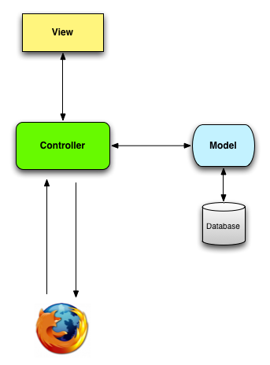
Model-View-Controller (MVC) Architectural Pattern
Server
Timeout!
What kind of diagram is this?
Ye Olde
Internet

Slide 26
Data Flow Diagrams
Server
components
flows
Ye Olde
Internet

Slide 27
Model-View-Controller (MVC) Architectural Pattern
Server
Timeout!
What do we mean by “architectural”?
Ye Olde
Internet

Slide 28
Two levels of software design
Architectural design: High-level structure of software system
Detailed design: Low-level design of individual components/modules/classes

Slide 29
Model-View-Controller (MVC) Architectural Pattern
Server
Being “architectural”, these components may contain many subcomponents (classes, etc.)
Ye Olde
Internet

Slide 30
MVC Component Responsibilities
Server
Ye Olde
Internet

Slide 31
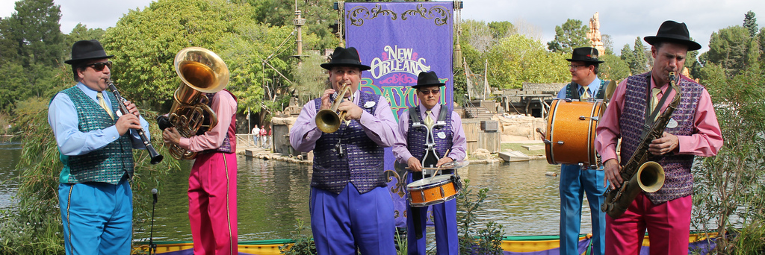
Responsibility-Driven Design
Frames object design as deciding
How to assign responsibilities to objects
How objects should collaborate
  What role each object should play in a collaboration
http://flic.kr/p/btp5ZK

Slide 32
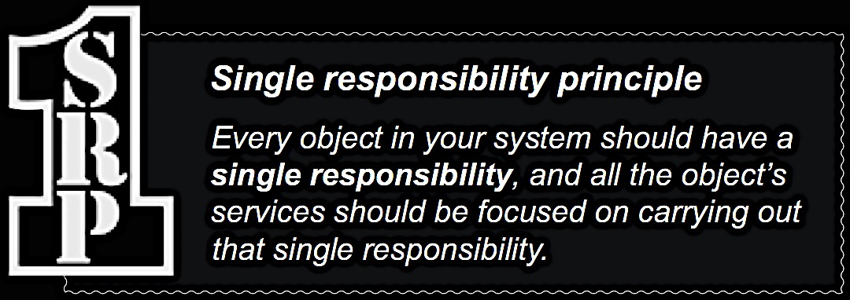

Slide 33
MVC Component Responsibilities
Server
View: Responsible for UI (generating HTML)
Ye Olde
Internet

Slide 34
MVC Component Responsibilities
Server
View: Responsible for UI (generating HTML)
Ye Olde
Internet
Model: Business logic, domain objects

Slide 35
MVC Component Responsibilities
Server
View: Responsible for UI (generating HTML)
Controller: Translates UI actions into operations on domain objects
Ye Olde
Internet
Model: Business logic, domain objects

Slide 36
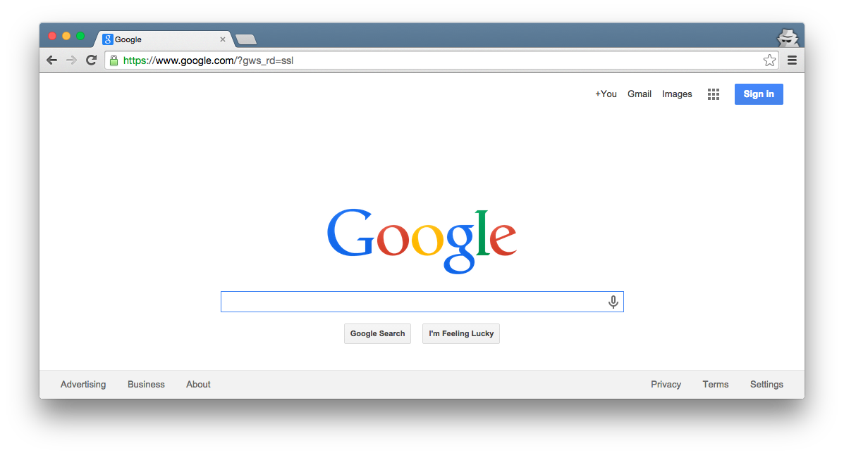

Rails MVC –
Fill in the blanks!
Browser
Ye Olde
Internet
DB
Server
???
???
???
???

Slide 37
Rails MVC –
Fill in the blanks!
Browser
Ye Olde
Internet
DB
Server
View
Router
Controller
Model

Slide 38
Browser
Router: Translates HTTP request
into call to controller method
Ye Olde
Internet
DB
Server
View
Router
Controller
Model

Slide 39
Browser
Programming a Rails web app mainly involves customizing the Router, Model, View, and Controller components
Ye Olde
Internet
DB
Server
View
Router
Controller
Model

Slide 40
Browser
Customize Ruby classes
Ye Olde
Internet
DB
Server
View
Router
Controller
Model

Slide 41
Browser
Customize Ruby block
Ye Olde
Internet
DB
Server
View
Router
Controller
Model

Slide 42
Browser
Customize ERB (Embedded Ruby) files
Ye Olde
Internet
DB
Server
View
Router
Controller
Model

Slide 43
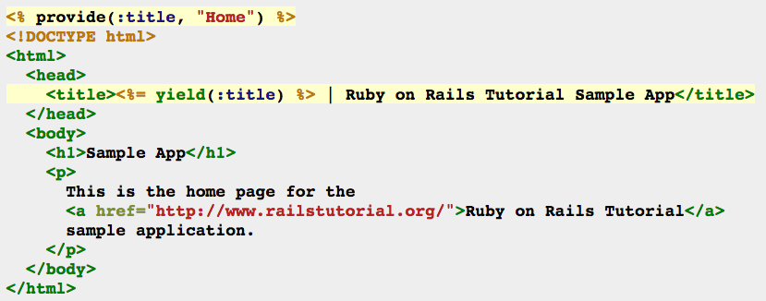
Example ERB: HTML with embedded Ruby code
<%= … %> executes embedded code and prints return value before printing subsequent HTML code
<% … %> executes embedded code before printing subsequent HTML code

Slide 44
Browser
Activity Time:
Let’s try programming
Rails *VC!
Ye Olde
Internet
DB
Server
View
Router
Controller
Model

